Slide 2
Evaluating Goal-oriented End-to-End Dialog Systems
Antoine Bordes - Facebook AI Research
Work with: Jason Weston, Y-Lan Boureau, Jesse Dodge, Andre Gane, Xiang Zhang, Alex Miller, Arthur Szlam, Sumit Chopra
NIPS – Let’s Discuss Workshop – December 10, 2016

Slide 3

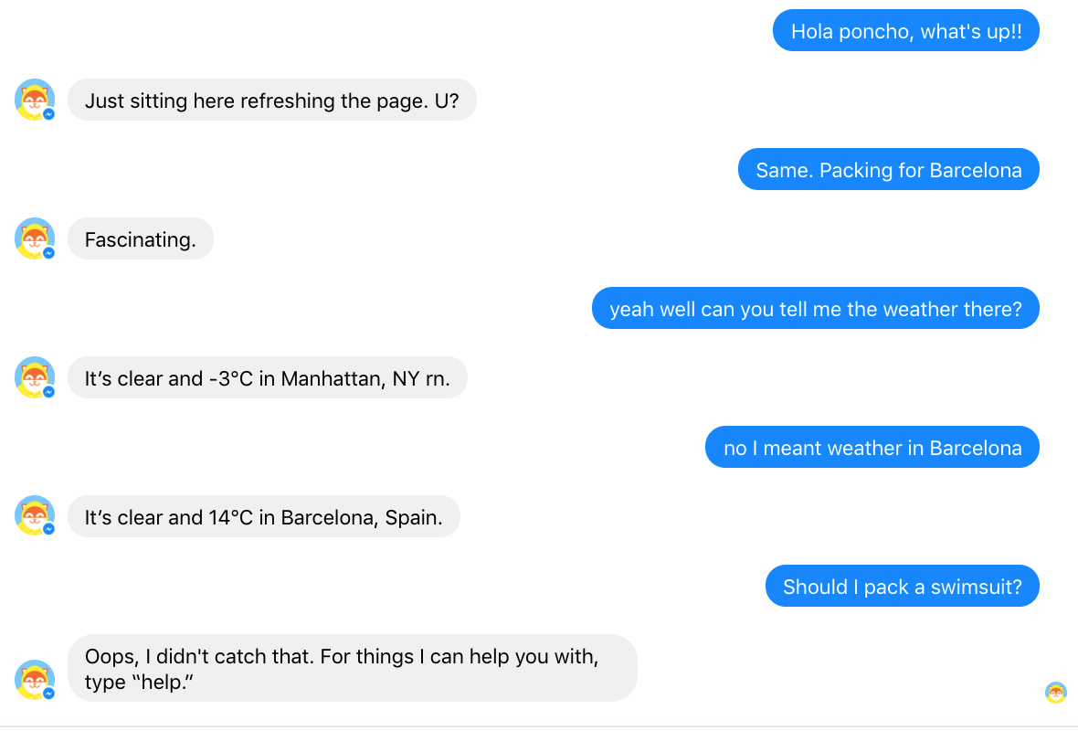

Bots! Bots! Bots!

Slide 4
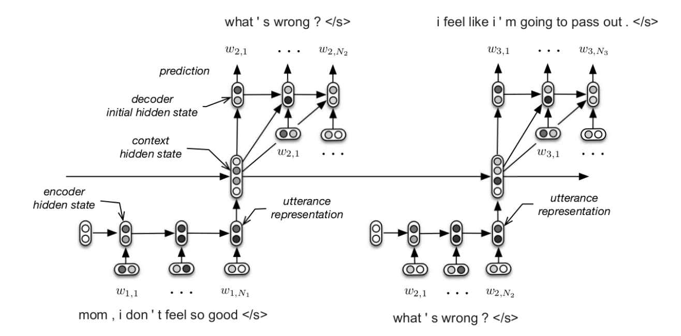

End-to-End dialog systems
From dialog history to next response directly.
(Shang et al., 15; Vinyals and Le, 15; Sordoni et al., 15; Serban et al., 15; Dodge et al., 16)
No intermediate task or state that can be used for training and evaluating.

Slide 5
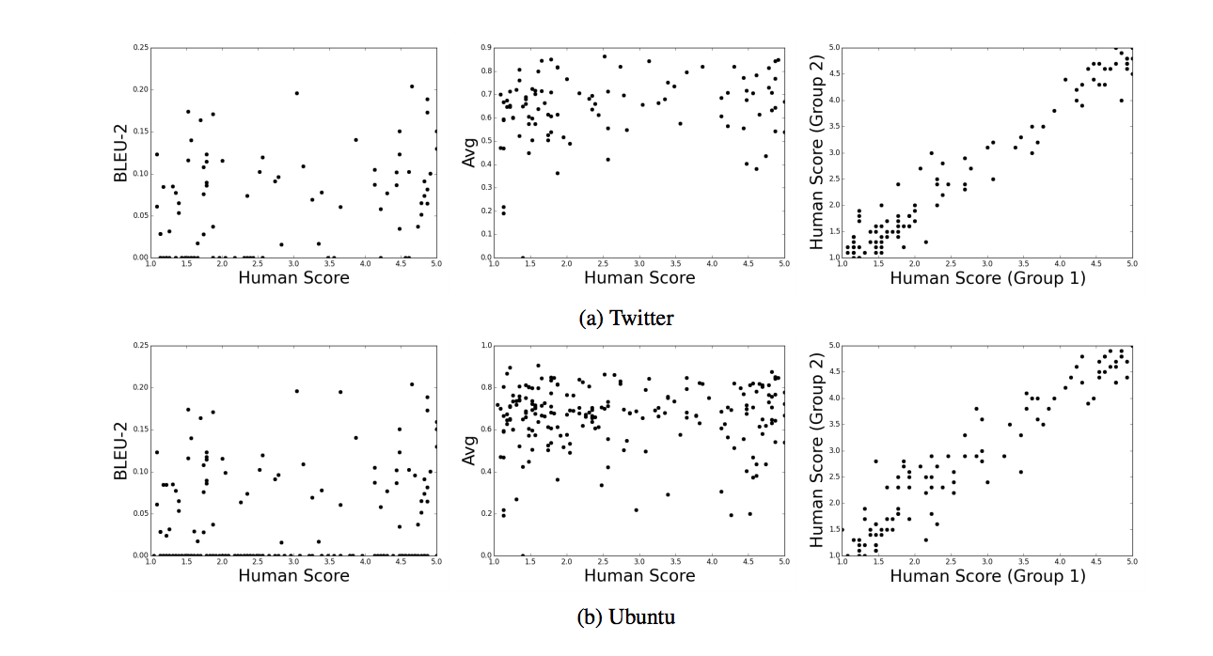
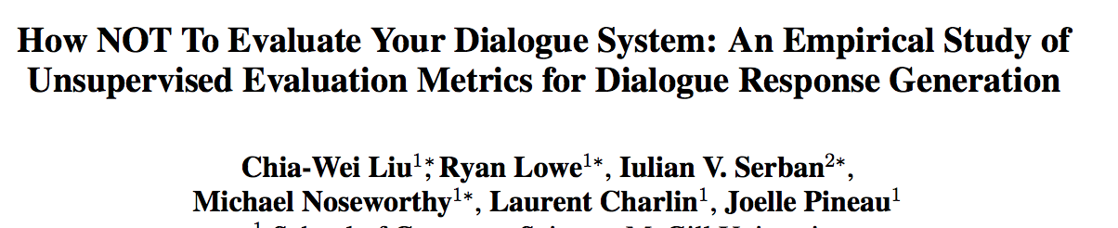
E2E dialog evaluation is hard
Human evaluations (AMT, etc.):
PROS: test fluency, task completion, actual task
CONS: costly, non-reproducible
Automatic evaluation (BLEU, perplexity, etc.)
PROS: fast, scalable, reproducible,
CONS: non-correlated with actual human evaluation
Back at simulation!?
(Yes Nina, this is coming back)
“many metrics commonly used in the literature for evaluating unsupervised dialogue systems do not correlate strongly with human judgement.”

Slide 6
bAbI Tasks for Q&A (Weston et al., ICLR16)
Set of 20 tasks testing basic reasoning capabilities for QA from stories
Short stories are generated from a simulation
Easy to interpret results / test a broad range of properties
Useful to foster innovation: cited ~150 times
John dropped the milk.
John took the milk there.
Sandra went to the bathroom.
John moved to the hallway.
Mary went to the bedroom.
Where is the milk ? Hallway
The suitcase is bigger than the chest.
The box is bigger than the chocolate.
The chest is bigger than the chocolate.
The chest fits inside the container.
The chest fits inside the box.
Does the suitcase fit in the chocolate? no
Task 3: Two supporting facts
Task 18: Size reasoning

Slide 8
Dashboard
Weakly supervised
Supervised Supp. Facts
TASK | N-grams | LSTMs | MemN2N | Memory Networks | StructSVM+coref+srl
T1. Single supporting fact | 36 | 50 | PASS | PASS | PASS
T2. Two supporting facts | 2 | 20 | 87 | PASS | 74
T3. Three supporting facts | 7 | 20 | 60 | PASS | 17
T4. Two arguments relations | 50 | 61 | PASS | PASS | PASS
T5. Three arguments relations | 20 | 70 | 87 | PASS | 83
T6. Yes/no questions | 49 | 48 | 92 | PASS | PASS
T7. Counting | 52 | 49 | 83 | 85 | 69
T8. Sets | 40 | 45 | 90 | 91 | 70
T9. Simple negation | 62 | 64 | 87 | PASS | PASS
T10. Indefinite knowledge | 45 | 44 | 85 | PASS | PASS
T11. Basic coreference | 29 | 72 | PASS | PASS | PASS
T12. Conjunction | 9 | 74 | PASS | PASS | PASS
T13. Compound coreference | 26 | PASS | PASS | PASS | PASS
T14. Time reasoning | 19 | 27 | PASS | PASS | PASS
T15. Basic deduction | 20 | 21 | PASS | PASS | PASS
T16. Basic induction | 43 | 23 | PASS | PASS | 24
T17. Positional reasoning | 46 | 51 | 49 | 65 | 61
T18. Size reasoning | 52 | 52 | 89 | PASS | 62
T19. Path finding | 0 | 8 | 7 | 36 | 49
T20. Agent’s motivation | 76 | 91 | PASS | PASS | PASS
Training on 1k stories

Slide 9
bAbI for end-to-end dialog systems
We propose to create bAbI taks for dialog.
Full control on the data.
Easy diagnostics.
No need for humans in the loop
No need for indirect metrics like BLEU, ROUGE, etc.
Able to assess the ability to complete a task (goal oriented setting)
Open-source see http://fb.ai/babi

Slide 10
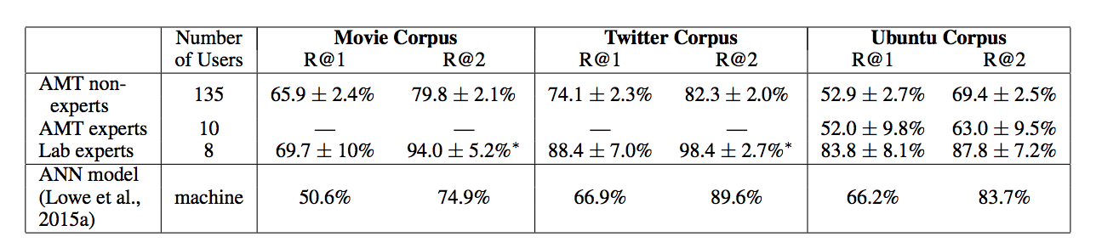
Next Utterance Classification
NUC: selecting the correct response from a candidate list.
Remove the difficulty of evaluating NL generation
Already difficult for current E2E systems!
Non-goal oriented dialogs

Slide 11
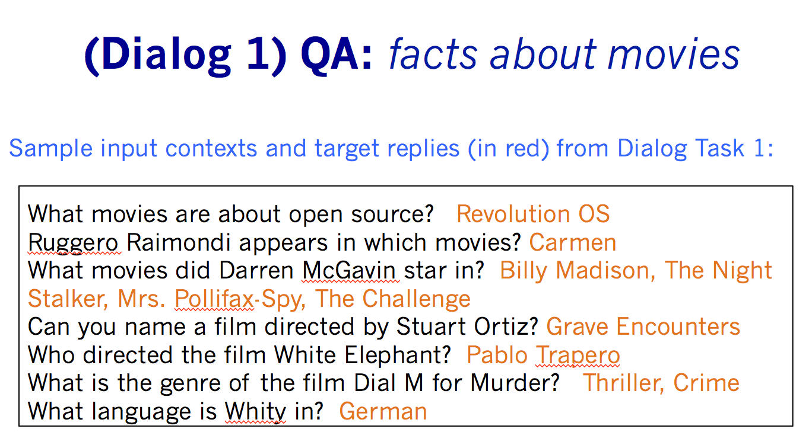
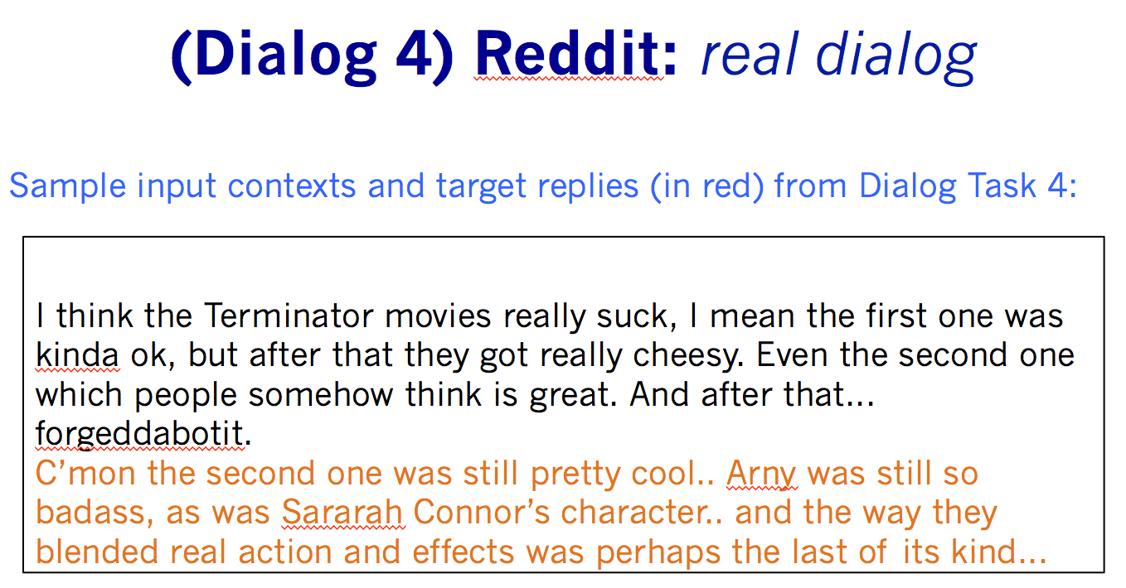
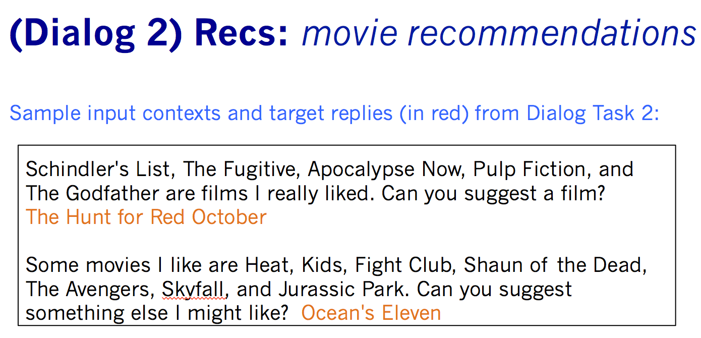
Vertical / Horizontal
Q&A
Chit-chat
Recommendation
Test multiple capabilities!
Gotta catch them all!
Transactional

Slide 12
Vertical

Slide 13
Creation of the dataset
Based on a simulation:
A KB made of restaurants and their properties: type of cuisine, location, price, rating, party size, address and phone number.
KB can be queried using API calls containing 4fields: location, type of cuisine, price range and party size.
Dialogs are generated after creating a user request by sampling an API call.
Each example is a dialog between a user and a bot, as well as API calls and the resulting facts.
NL patterns are used to create user and bot utterances.

Slide 14
Slicing a booking in five tasks
Task completed
=
All utterances correctly predicted

Slide 15
Additions
Out-of-vocabulary words: a 2nd test set uses entities not in train.
Extra sources:
Dialog State Tracking Challenge 2: we converted data from DSTC2 (Henderson et al., 2014a), also in the restaurant booking domain to create Task 6.
Concierge:
We also evaluate our on data extracted from a real online concierge service performing restaurant booking.
Users make requests through a text-based chat interface that are handled by humans.
All conversations are between native English speakers.

Slide 16
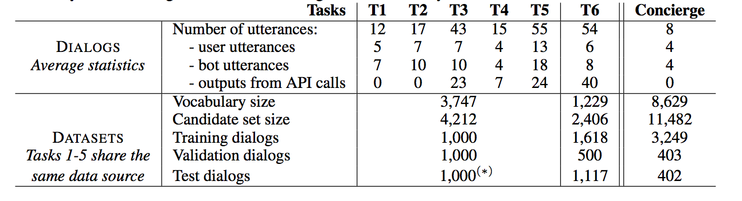
Stats

Slide 17

Related resources
DSTC datasets (Kim et al., 2016)
Cortana-based (Chen et al. (2016) (proprietary)
SFCore (Gašic et al., 2014)
ATIS (Dahl et al., 1994).
bAbI dialog:
Open-source
Noise-free
Deterministic
Progressive difficulty

Slide 18
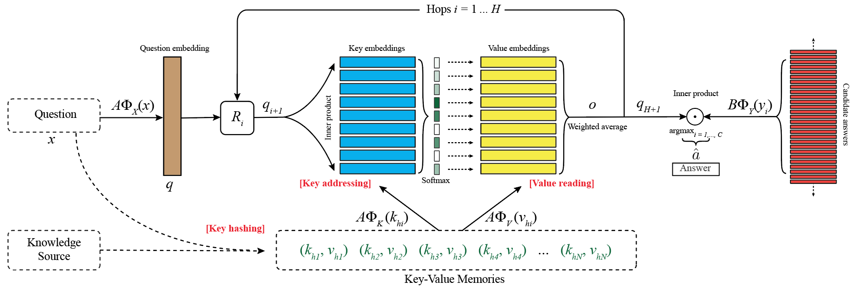
E2E candidate: Memory Networks
In Barcelona
How many …
How many people in your party ?
(m₁, m₂, m₃, m₄, …)
(m₁, m₂, m₃, m₄, …)
m1: U: Hi
m2: B: Hello
I’m on it
John
Memories
m4: B: Sure thing
U: Hi
B: Hello
U: I would like a table for two
B: Sure thing
B: Where would that be ?
Memories
m5: B: Where would that be?
Hi
m3: U: I would like a table for two
…

Slide 19
Dashboard
 | IR (TF-IDF) | LSTMs | Embeddings | Memory Networks | Top perf
T1 – API calls | 5.6 | / | 100 | 99.9 | 100
T2 – Update API calls | 3.4 | / | 68.4 | 100 | 100
T3 – Show options | 8.0 | / | 64.9 | 74.9 | 100
T4 – Extra information | 9.5 | / | 57.2 | 59.5 | 100
T5 – Full dialogs | 4.6 | / | 75.4 | 96.1 | 100
T6 – DSTC2 | 1.6 | / | 22.6 | 41.1 | ?
T7 – Concierge | 1.1 | / | 14.6 | 16.7 | ?
Memory Networks can not learn to use the KB
All datasets agree

Slide 20
Dashboard
 | IR (TF-IDF) | LSTMs | Embeddings | Memory Networks | Top perf
T1 – API calls | 0 | / | 100 | 99.6 | 100
T2 – Update API calls | 0 | / | 0 | 100 | 100
T3 – Show options | 0 | / | 0 | 2.0 | 100
T4 – Extra information | 0 | / | 0 | 3.0 | 100
T5 – Full dialogs | 0 | / | 0 | 49.4 | 100
T6 – DSTC2 | 0 | / | 0 | 0 | ?
T7 – Concierge | 0.2 | / | 0.5 | 1.2 | ?
Task completion is a much harder metric!

Slide 21
Dashboard
 | IR (TF-IDF) | LSTMs | Embeddings | Memory Networks | Top perf
T1 – API calls | 5.6 | / | 100 | 99.9 | 100
T2 – Update API calls | 3.4 | / | 68.4 | 100 | 100
T3 – Show options | 8.0 | / | 64.9 | 74.9 | 100
T4 – Extra information | 9.5 | / | 57.2 | 59.5 | 100
T5 – Full dialogs | 4.6 | / | 75.4 | 96.1 | 100
T6 – DSTC2 | 1.6 | / | 22.6 | 41.1 | ?
T7 – Concierge | 1.1 | / | 14.6 | 16.7 | ?
What if Out-of-Vocabulary entities?

Slide 22
Dashboard
 | IR (TF-IDF) | LSTMs | Embeddings | Memory Networks | Top perf
T1 – API calls | 5.8 +0.2 | / | 60.0 -40.0 | 72.3 -27.6 | 100
T2 – Update API calls | 3.5 +0.1 | / | 68.3 -0.1 | 78.9 -21.1 | 100
T3 – Show options | 8.3 +0.3 | / | 65.0 +0.1 | 74.4 -0.5 | 100
T4 – Extra information | 9.8 +0.3 | / | 57.0 -0.2 | 57.6 -1.9 | 100
T5 – Full dialogs | 4.6 +0.0 | / | 48.2 -27.2 | 65.5 -30.6 | 100
T6 – DSTC2 | 1.6 | / | 22.6 | 41.1 | /
T7 – Concierge | 1.1 | / | 14.6 | 16.7 | /
What if Out-of-Vocabulary entities?
OOV are not obvious for embedding-based models.

Slide 23
Dashboard
Memory Networks + type features
96.5
94.5
75.2
100
77.7
41.0
 | IR (TF-IDF) | LSTMs | Embeddings | Memory Networks | Top perf
T1 – API calls | 5.8 +0.2 | / | 60.0 -40.0 | 72.3 -27.6 | 100
T2 – Update API calls | 3.5 +0.1 | / | 68.3 -0.1 | 78.9 -21.1 | 100
T3 – Show options | 8.3 +0.3 | / | 65.0 +0.1 | 74.4 -0.5 | 100
T4 – Extra information | 9.8 +0.3 | / | 57.0 -0.2 | 57.6 -1.9 | 100
T5 – Full dialogs | 4.6 +0.0 | / | 48.2 -27.2 | 65.5 -30.6 | 100
T6 – DSTC2 | 1.6 | / | 22.6 | 41.1 | /
T7 – Concierge | 1.1 | / | 14.6 | 16.7 | /
What if Out-of-Vocabulary entities?
Adding type features can help to fix some limitations

Slide 24
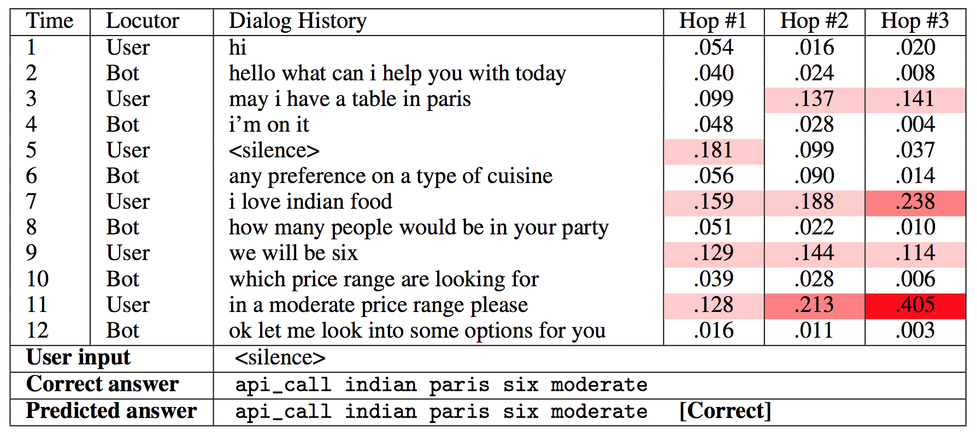
E2E API call prediction

Slide 25
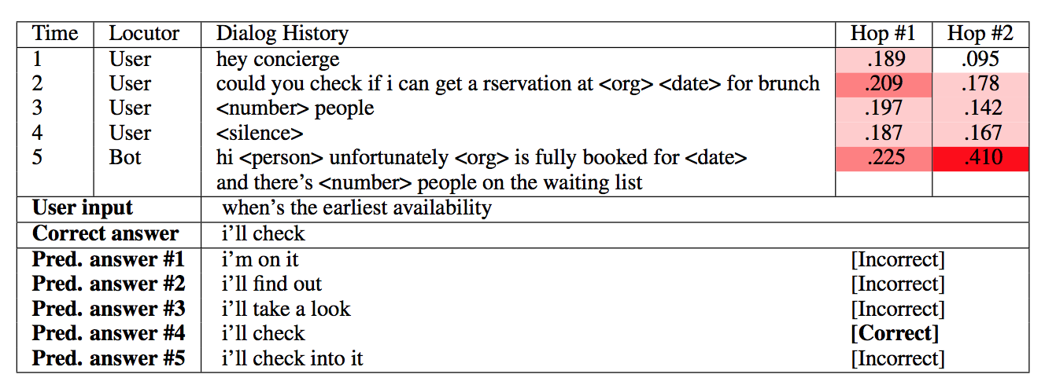
E2E on Concierge

Slide 26
Horizontal

Slide 27
Joint testing on different tasks
True AI should be open-domain!
We have also built a Movie Dialog Dataset (Dodge et al., ICLR16)
Closed, but large, domain about movies (75k entities, 3.5M ex).
Ask facts about movies?
Ask for opinions (recommendations) about movies?
Dialog combining facts and opinions?
General chit-chat about movies (statements not questions)?
And… combination of all above in one end-to-end model.

Slide 28
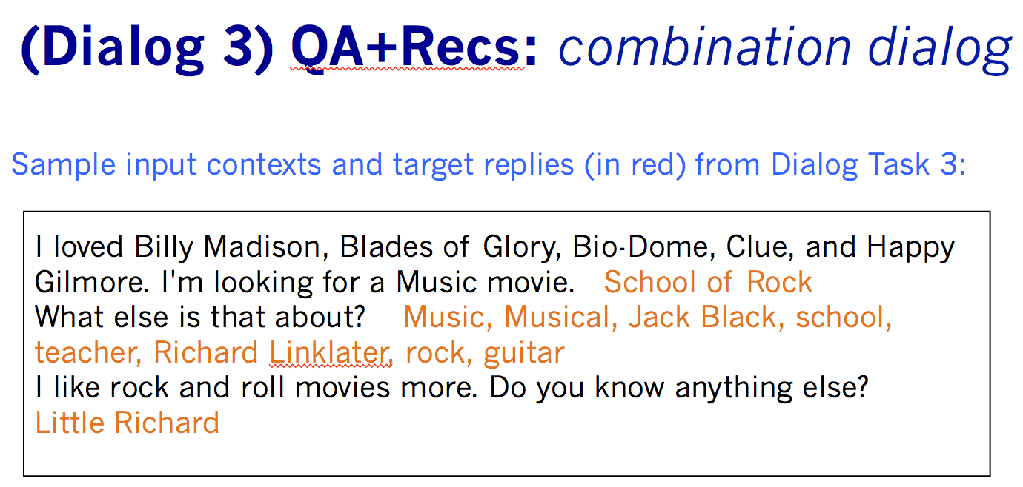
Combines QA with Dialog Tasks (Dodge et al., ICLR16)

Slide 29
Dashboard
JOINT SUPERVISED EMBEDDINGS 43.6 28.1 58.9 14.5
JOINT MEMN2N 83.5 26.5 78.9 26.6
 | IR (TF-IDF) | LSTMs | Embeddings | Memory Networks | Top perf
T1 – API calls | 5.6 | / | 100 | 99.9 | 100
T2 – Update API calls | 3.4 | / | 68.4 | 100 | 100
T3 – Show options | 8.0 | / | 64.9 | 74.9 | 100
T4 – Extra information | 9.5 | / | 57.2 | 59.5 | 100
T5 – Full dialogs | 4.6 | / | 75.4 | 96.1 | 100
T6 – DSTC2 | 1.6 | / | 22.6 | 41.1 | /
T7 – Concierge | 1.1 | / | 14.6 | 16.7 | /
QA Task | / | 6.5 | 50.9 | 79.3 | 90.7
Recs Task | / | 27.1 | 29.2 | 28.6 | /
QA+Recs Task | / | 19.9 | 65.9 | 81.7 | /
Reddit Task | 23.7 | 11.8 | 27.6 | 29.2 | /
What if joint training?

Slide 30
Dashboard
 | IR (TF-IDF) | LSTMs | Embeddings | Memory Networks | Top perf
T1 – API calls | 5.6 | / | 100 | 99.9 | 100
T2 – Update API calls | 3.4 | / | 68.4 | 100 | 100
T3 – Show options | 8.0 | / | 64.9 | 74.9 | 100
T4 – Extra information | 9.5 | / | 57.2 | 59.5 | 100
T5 – Full dialogs | 4.6 | / | 75.4 | 96.1 | 100
T6 – DSTC2 | 1.6 | / | 22.6 | 41.1 | /
T7 – Concierge | 1.1 | / | 14.6 | 16.7 | /
QA Task | / | 6.5 | 43.6 -7.3 | 83.3 +4.0 | 90.7
Recs Task | / | 27.1 | 28.1 -1.1 | 26.5 -2.1 | /
QA+Recs Task | / | 19.9 | 58.9 -7.0 | 79.9 -1.8 | /
Reddit Task | 23.7 | 11.8 | 14.5 -13.1 | 26.6 -2.6 | /
What if joint training?
Still need to figure out multi-task!
Notes:
JOINT SUPERVISED EMBEDDINGS 43.6 28.1 58.9 14.5
JOINT MEMN2N 83.5 26.5 78.9 26.6

Slide 31
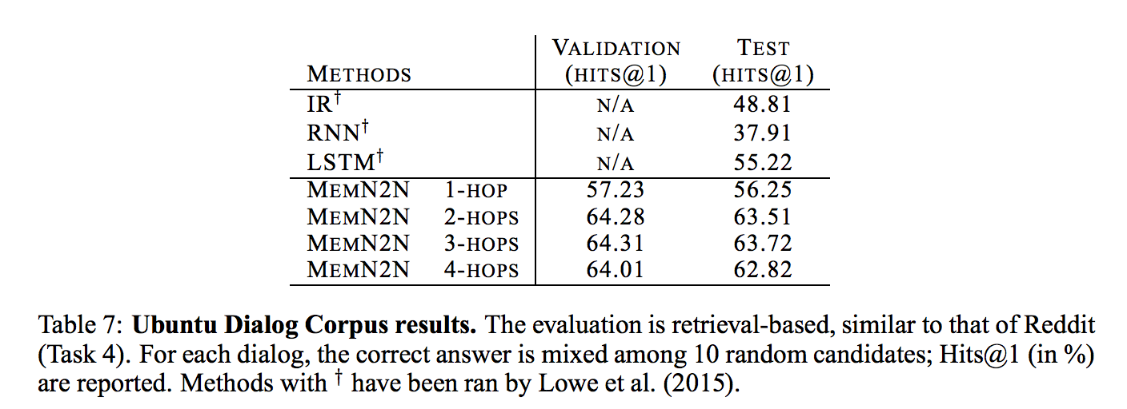
Ubuntu Data (Lowe et al. McGill, ‘15)
Dialog dataset: Ubuntu IRC channel logs, users ask questions about issues they are having with Ubuntu and get answers by other users.
Best current results: “Sentence Pair Scoring: Towards Unified Framework for Text Comprehension” (Baudis et al., 2016) => RNN-CNN combo: 67.2

Slide 32
Moving to interaction (Weston, NIPS16)
Mary went to the hallway.
John moved to the bathroom.
Mary travelled to the kitchen.
Where is Mary? A:playground
No, that's incorrect.
Where is John? A:bathroom
Yes, that's right!
If you can predict this, you are most of the way to knowing how to answer correctly.

Slide 33
Human Responses Give Lots of Info
Mary went to the hallway.
John moved to the bathroom.
Mary travelled to the kitchen.
Where is Mary? A:playground
No, the answer is kitchen.
Where is John? A:bathroom
Yes, that's right!
Much more signal than just “No” or zero reward.

Slide 34
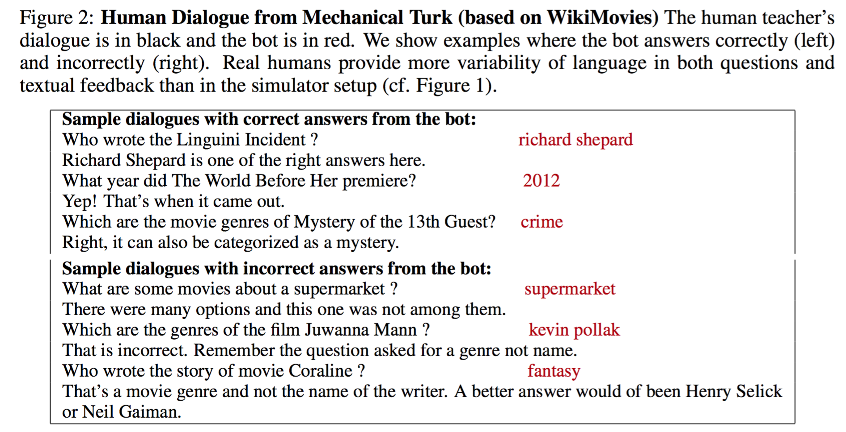
Real Human Questions+Feedback (Li et al., 16)
Much more diversity!!

Slide 35
Next Steps

Slide 36
In summary
Collection of tasks can be valuable for E2E dialog evaluations
Identified issues:
Interaction with symbolic DB?
Out-of-Vocabulary words?
Joint learning?
Transfer learning?
Learning from language interactions?
Not limited to dialog tasks!

Slide 37
Dashboard
 | IR (TF-IDF) | LSTMs | Embeddings | Memory Networks | Top perf
T1 – API calls | 5.6 | / | 100 | 99.9 | 100
T2 – Update API calls | 3.4 | / | 68.4 | 100 | 100
T3 – Show options | 8.0 | / | 64.9 | 74.9 | 100
T4 – Extra information | 9.5 | / | 57.2 | 59.5 | 100
T5 – Full dialogs | 4.6 | / | 75.4 | 96.1 | 100
T6 – DSTC2 | 1.6 | / | 22.6 | 41.1 | /
T7 – Concierge | 1.1 | / | 14.6 | 16.7 | /
QA Task | / | 6.5 | 50.9 | 79.3 | 90.7
Recs Task | / | 27.1 | 29.2 | 28.6 | /
QA+Recs Task | / | 19.9 | 65.9 | 81.7 | /
Reddit Task | 23.7 | 11.8 | 27.6 | 29.2 | /

Slide 38
Dashboard
 | IR (TF-IDF) | LSTMs | Embeddings | Memory Networks | Top perf
T1 – API calls | 5.6 | / | 100 | 99.9 | 100
T2 – Update API calls | 3.4 | / | 68.4 | 100 | 100
T3 – Show options | 8.0 | / | 64.9 | 74.9 | 100
T4 – Extra information | 9.5 | / | 57.2 | 59.5 | 100
T5 – Full dialogs | 4.6 | / | 75.4 | 96.1 | 100
T6 – DSTC2 | 1.6 | / | 22.6 | 41.1 | /
T7 – Concierge | 1.1 | / | 14.6 | 16.7 | /
QA Task | / | 6.5 | 50.9 | 79.3 | 90.7
Recs Task | / | 27.1 | 29.2 | 28.6 | /
QA+Recs Task | / | 19.9 | 65.9 | 81.7 | /
Reddit Task | 23.7 | 11.8 | 27.6 | 29.2 | /
bAbI Tasks (10k) | / | 63.6 | 84.6 | 95.8 | 99.5
CBT - NE | 16.8 | 43.6 | 40.2 | 66.6 | 75.0
CBT - CN | 19.6 | 58.2 | 50.6 | 63.0 | 72.0
SimpleQuestions | / | / | / | 63.9 | /
WikiMovies | / | / | 54.4 | 78.5 | 93.5
Adding QA datasets to the picture?
Notes:
SOTA CBT: WORDS OR CHARACTERS? FINE-GRAINED GATING FOR READING COMPREHENSION Zhilin Yang, Bhuwan Dhingra, Ye Yuan, Junjie Hu, William W. Cohen, Ruslan Salakhutdinov

Slide 39
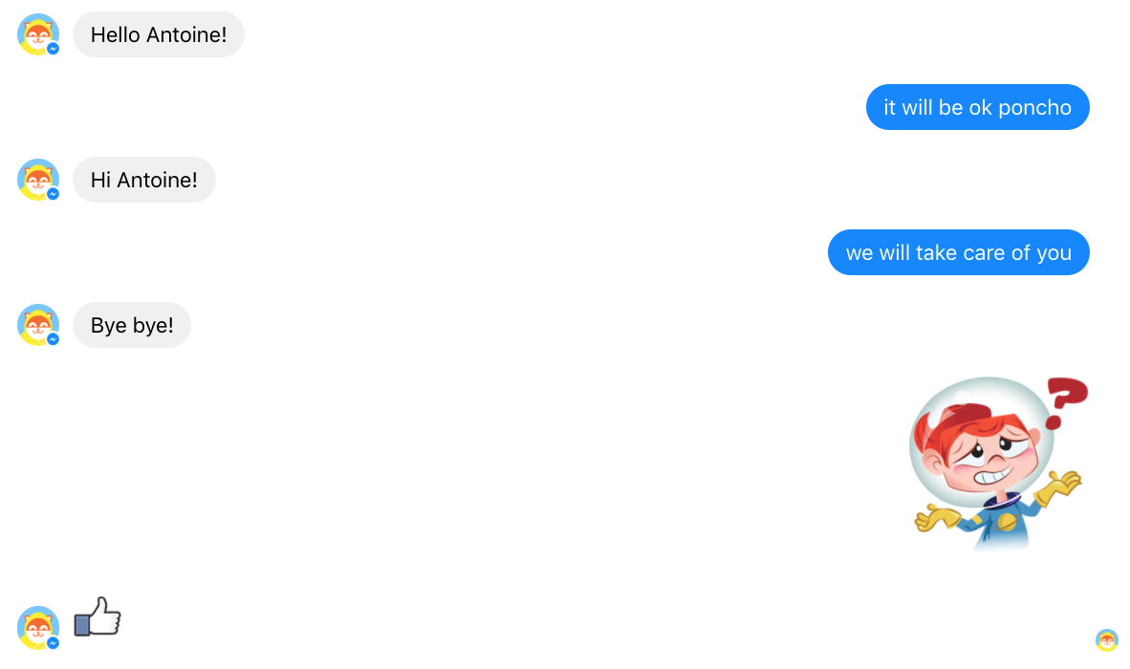
Let’s help Poncho!

Slide 40
Open Research
Papers:
Key-Value Memory Networks: http://arxiv.org/abs/1606.03126
Memory Networks: http://arxiv.org/abs/1410.3916
End-to-end Memory Networks: http://arxiv.org/abs/1503.08895
bAbI tasks: http://arxiv.org/abs/1502.05698
Children’s Books Test: http://arxiv.org/abs/1511.023701
Large-scale QA with Memory Networks: http://arxiv.org/abs/1506.02075
Evaluating pre-requisite qualities of dialog systems: http://arxiv.org/abs/1511.06931
Dialog bAbI tasks: http://arxiv.org/abs/1605.07683
Dialog-based language learning: http://arxiv.org/abs/1604.06045
Data: fb.ai/babi (7 datasets including bAbI tasks and Movie Dialog Data)
Code:
Memory Networks: https://github.com/facebook/MemNN
bAbI tasks generator: https://github.com/facebook/bAbI-tasks
MemNN
Q&A
Dialog

Slide 42
Key-Value Memory Network (Miller et al., ‘16)
Encode Prior Knowledge: if k_i matches q, v_i matches output better results

Slide 43
Forward Prediction Memory Network (Weston, ‘16)
new state of world
“Unsupervised” Forward Model: does not require labeled supervision

Slide 44
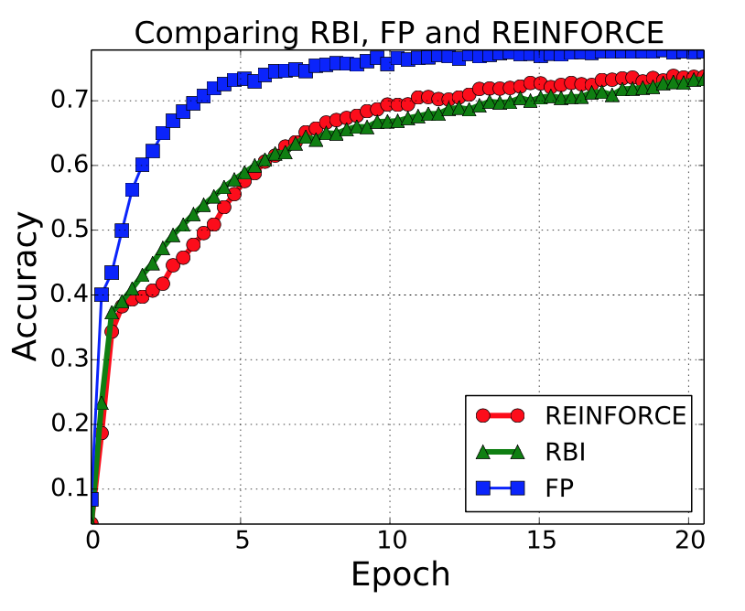
Dialog Feedback: Results
WikiMovies (templated task)
Forward Prediction MemNN (FP) which uses textual rewards
can perform better than using numerical rewards (RBI or REINFORCE)!!

